Slide 1
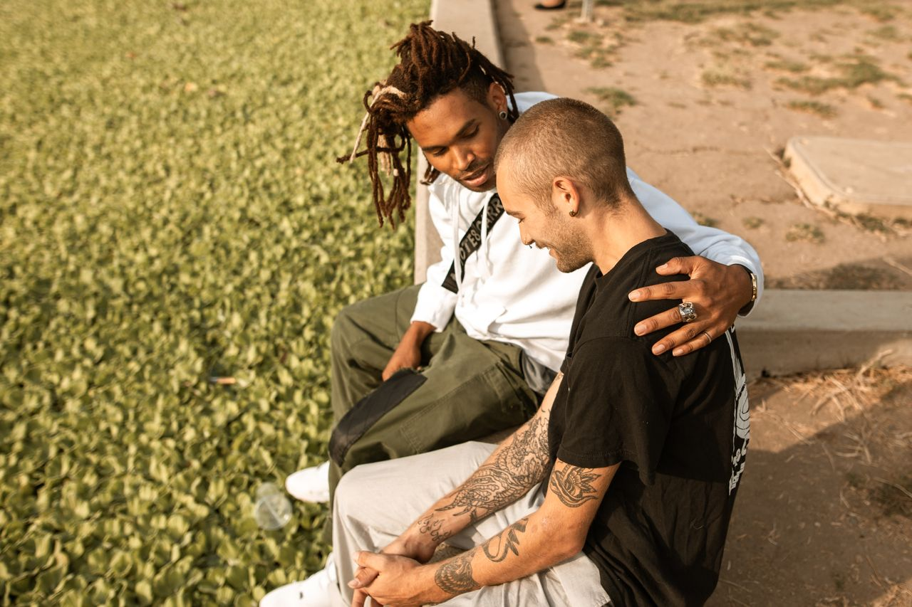
Your Feelings
Are Normal
Grades 4–6
Together For Health

Slide 2

💛
Here Is Something Important
1 in 5 kids will deal with a mental health problem.
That's about 6 people in a class of 30. You are not alone.
Together For Health

Slide 3

💭
What Is Mental Health?
Your mental health is how you think, feel, and cope
It changes from day to day — that is completely normal
Just like your body can get sick, your mind can too
And just like your body, your mind can heal
Together For Health

Slide 4
😊
Normal vs. Getting Help
Feeling sad after something bad — normal
Feeling nervous before a test — normal
Feeling sad or scared for weeks for no reason — get help
There is zero shame in asking for support
Together For Health

Slide 5
🌿
When You Feel Overwhelmed
Take 5 slow, deep breaths
1
Say what you are feeling: 'I feel anxious'
2
Do something physical — walk, stretch, or dance
3
Talk to someone you trust
4
Together For Health

Slide 6
Who Can Help?
At School
Outside School
Your teacher
A parent or guardian
School counsellor
Kids Help Phone (free + private)
A friend you trust
Your doctor
Together For Health

Slide 7
KEY TAKEAWAYS
Your feelings are always valid
✓
Asking for help is brave
✓
You do not have to figure it out alone
✓
Resources
Kids Help Phone: 1-800-668-6868
Text HOME to 686868 (free, 24/7)
Talk to a trusted adult today
Together For Health

